Slide 1
PDS Form Overview and Instructions for Completing 包装数据表填写手册
Cummins Global Packaging Council
Sep 14 2017
Internal Use Only

Slide 2
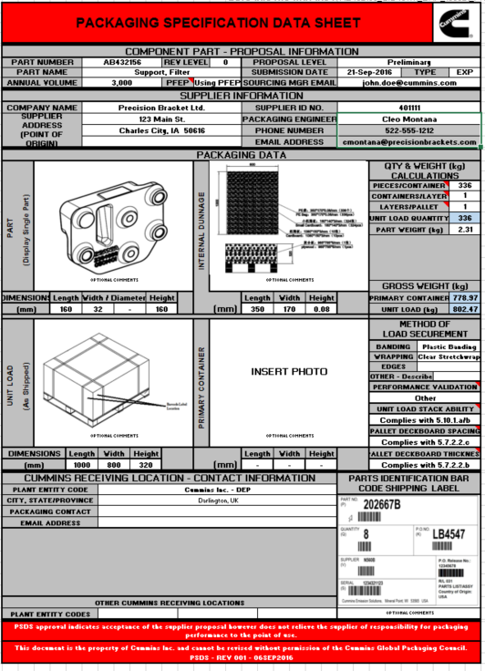
PDS Form Example 包装数据表例子
First Tab of the PDS Form (PSDS) 包装方案数据表，见左图
1 PDS Form per part number 一个零件一张此表
Part / Supplier info 零件/供应商信息
4 photos 4 张照片
Quantities 数量
Dimensions (mm) 尺寸（毫米）
Part Weight (kg) 零件重量（公斤）
Cummins Barcode label image（Cummins 条码标签图示）

Slide 3
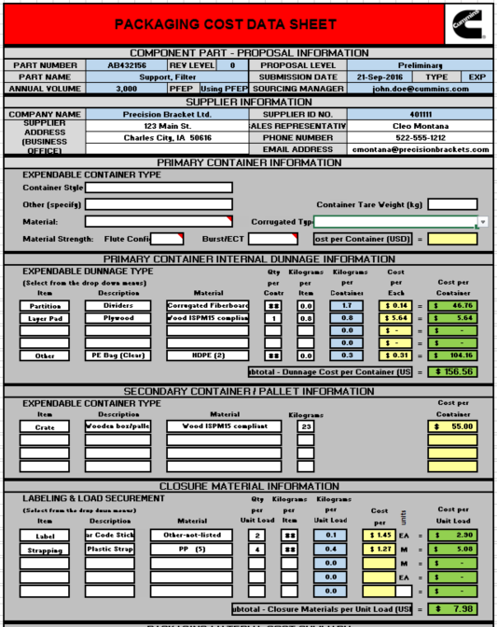
PDS Form Example 包装价格信息表
Second tab of PDS Form (PCDS)包装价格明细表（见左图）
Packaging BOM 包装BOM
Packaging Material Descriptions包装材料描述
Quantity 数量
Weight 重量
Itemized Packaging Material Cost 按下拉菜单里提示的包装材料对应的成本信息

Slide 4
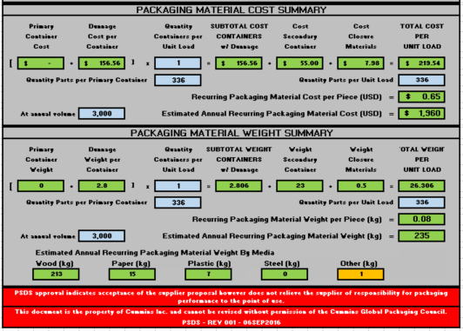
PDS Form Example 包装价格信息表
Auto-calculated Summary 自动计算结果
Recurring Material Costs常规包装材料成本
Recurring Material Weights 常规包装材料重量

Slide 5
How do we complete the PDS Form properly?
如何正确及完整的填写PDS数据表
FIRST……..let’s look at each section of the PDS Form to better understand what is required
首先…..让我们一起看下PDS表格里的每个字段以更好的了解我们的需求

Slide 6
PSDS Component and Supplier Info 包装方案信息表的元素及供应商信息
Type ：指是一次性包装还是循环包装
Projected Annual Volume is entered here年度估计使用量
Enter
Cummins Part number here 输入康明斯的零件号
Select from the drop down whether PDS is Preliminary or Change Proposal 下拉菜单选择此包装方案为初次提交还是修改方案
Enter Part noun name description here输入零件描述
Enter Cummins Sourcing Managers email address here (NOTE: Approval or Revisions Required Notifications will be automatically sent to the Sourcing Manager) 输入康明斯采购经理邮件地址
Enter the Supplier SIM# assigned by Cummins Sourcing Manager here for this Supplier输入康明斯采购经理提供的康明斯供应商SIM 编码
Enter the Supplier’ Packaging Contact phone number and email address here (NOTE: Approval or Revisions Required Notifications will be automatically sent to the Supplier) 输入供应商包装人员联系电话和邮件
Enter the Supplier name and address here输入供应商名称和地址
Enter the Supplier’ Packaging Contact Person’s name here 输入供应商包装联系人名字

Slide 7
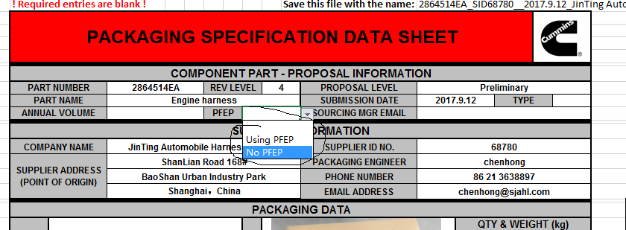
PSDS Component and Supplier Info 包装方案信息表的元素及供应商信息
如果康明斯的工厂正在使用“PFEP”，选择“using PFEP”，相反选“NO PFEP”。

Slide 8
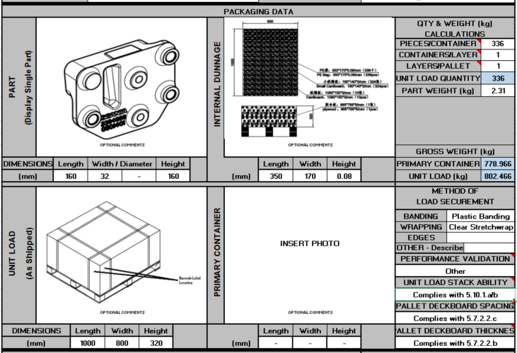
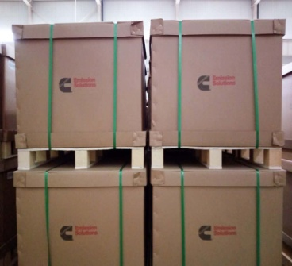
PSDS Packaging Data Section (Bulk Pack) 包装方案信息表的关键信息（整包装）
Enter the number of containers per layer here if primary containers are used. If Bulk as in this example it would be 1（如果使用了一级包装，请在此输入每层一级包装的数量）如果是此页所展示的大包装形式，请直接输入1
Enter the total number of parts in the primary or bulk container here 输入一级包装里零件的数量
Place jpeg photo of the part itself here 置入JPEG格式图片在此
Enter the number of layers of primary containers per unit load here. If bulk container used as in this example it would also be 1 （输入每一单位运输包装一级包装箱的层数）如果是大箱子，直接写1
Enter dimensions of the part here in mm 输入零件尺寸（毫米）
Enter internal dunnage dimensions 输入内部内衬尺寸
Enter weight of the part here in kg 输入零件的重量
Place jpeg photo of how the part is packaged inside the carton here showing the internal dunnage and use of VCI if applicable 置入JPEG格式照片，照片能够反映零件如何再箱子里放置，以及VCI的使用情况（如果适用）
Place jpeg photo of the unit load here在此处放一张JPEG格式的发运照片
Indicate what packaging performance validation testing was done. 标明做过哪种形式的包装性能验证
Select from the appropriate drop downs based on the method of securement used 基于安全装载的方式，在下拉菜单中选择合适选项
Enter dimensions of the Unit Load here in mm 输入运输包装的整体尺寸（毫米）
Supplier is required to confirm if their packaging complies with the GPS-PP Pallet Construction requirements. Check the appropriate boxes here 要求供应商确认是否包装符合康明斯全球包装规范里对托盘的相关要求或指令
如果是整包装“bulk pack”，此框里不需要贴任何图片
左图示例为“Bulk Pack”，即运输包装为一整体包装单元

Slide 9
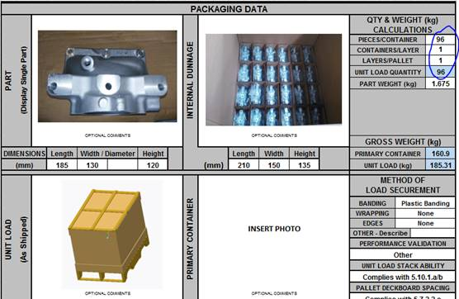
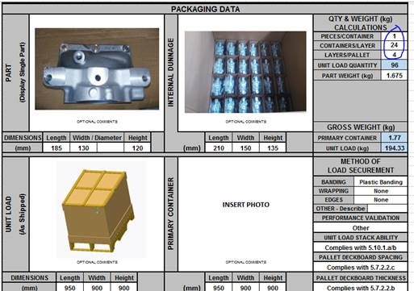
PSDS Packaging Data Section (Bulk Pack) 包装方案信息表的关键信息（整包装）
A
B
如果整包装里的内包装形式类似如上图片，关于内包装的信息建议A 的填写方法！
左图示例为“Bulk Pack”，即运输包装为一整体包装单元

Slide 10
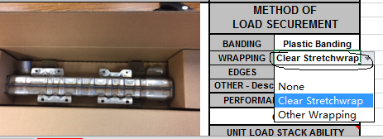
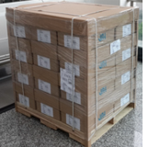
Method of load securement 装载防护的方式
如果是“Primary Pack”，即如下A图，必须使用拉伸缠绕膜进行整体防护，A图的形式就可以选择“Clear Stretchwrap” ；
如果是“Bulk Pack”，即如下B图，拉伸缠绕膜不是必须要求。
A with film protect 有缠绕膜防护
B without film protect
无缠绕膜防护

Slide 11
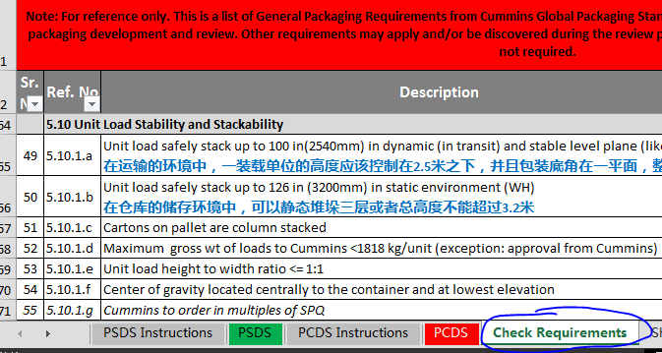
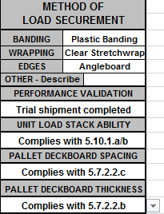
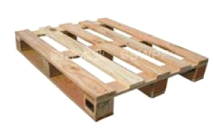
Method of load securement 装载防护的方式
木托盘的条形面板之间的空隙不能超过76.2mm
木托盘的条形面板的厚度必须大于13mm
5.7.2.2.b | Deck boards thickness >= 0.5 in (13mm)木托盘的条形面板的厚度必须大于13mm
5.7.2.2.c | Open space between top deck boards < 3in (76.2mm)木托盘的条形面板之间的空隙不能超过76.2mm
5.10.1.a | Unit load safely stack up to 100 in(2540mm) in dynamic (in transit) and stable level plane (like freight) 在运输的环境中，一装载单位的高度应该控制在2.5米之下，并且包装底角在一平面，整体包装重心平稳
5.10.1.b | Unit load safely stack up to 126 in (3200mm) in static environment (WH) 在仓库的储存环境中，可以静态堆垛三层或者总高度不能超过3.2米

Slide 12
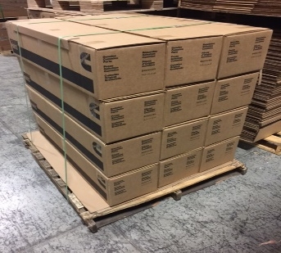
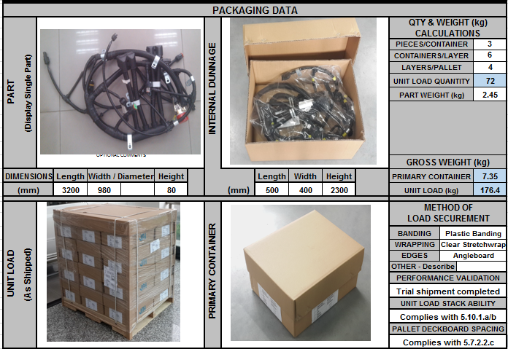
PSDS Packaging Data Section (Primary Pack) Example of Packaging Data entry for a Primary Container PSDS 包装方案表（分级包装） 一级包装箱信息输入案例
一级包装里零件的个数.
Primary containers per layer and the number of layers of primary containers that would be on your unit load would be entered here
请在此输入每层小箱子的数量和托盘上一级包装的层数 .
如上图片为
“Primary Pack”
(即由若干独立包装组成的运输包装单元- 一级包装）
请放置一级包装的图片！

Slide 13
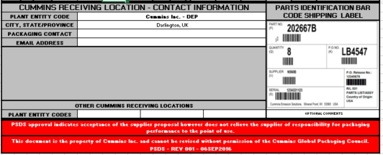
PSDS Cummins Contact Info, Approval Signoff and AIAG Shipping Label PSDS 康明斯联系联系信息，批准签署和AIAG 发运标签
Place a jpeg photo of the AIAG Bar Code Shipping Label here.放置一张JPEG格式的图片来呈现AIAG条形码发运标签
If you are sending this same part and packaging to other Cummins plants, enter their appropriate Entity codes here. This entity code can be obtained from the CMI Global Plant Packaging Contact List that you get from the Cummins Sourcing Mgr.如果你正在发运同样的零件给康明斯
其他工厂，请在此输入正确的工厂代码。工厂代码可以从由康明斯采购经理提供的CMI 全球工厂包装联系表里查到。
Enter the Cummins receiving plant address, site packaging contact name, and email address from the CMI Global Plant Packaging Contact List provided to you by the Cummins Sourcing Manager输入康明斯收货工厂地址，工厂的包装联系人姓名、邮箱地址
NOTE: The approval of this PDS Form does not negate the responsibility of the Supplier for the performance of this packaging. Only that Cummins approves that you have met our Pkg Stds and plant specific requirements.
注意:PDS表的批准并不意味着供应商可以不为包装的实际表现状况承担责任。只是表示康明斯批准了大家符合了我们的标准标准和工厂的具体要求。

Slide 14
PDS Form Cost Data Component and Supplier Info
All the blue fields will autofill from the input of the PDS Form. No need to enter redundant data points.蓝色部分不需要人工输入，它们为表格里自动计算部分
NOTE: Only itemized packaging material costs and weights for expendable packaging material should be entered into the PCDS
注意： 只有下拉菜单里所列示的一次性包装材料的材料成本和重量需要输入到包装成本信息表里。

Slide 15
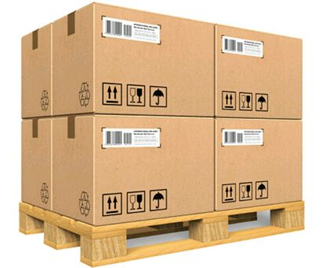
PDS Form Cost Data - Primary Container Section 包装信息表成本信息 - 一级包装部分
Use the drop down menu in this cell to select the specific container style 使用下拉菜单选择具体的包装箱类型 .
Manually enter the empty container weight here手工输入空箱重量 .
Manually enter OTHER container style not listed in the drop down menu for container style 手工输入下拉菜单里不存在的其他包装箱类型 .
每独立纸箱为一级包装
Manually enter the cost per primary container here 手工输入每个一级包装的成本信息
Use these drop down menus in this cell to select the specific container material 使用在此单元的下拉菜单选择具体的包装箱材料类型 .
Use these drop down menus in this cell to select the specific corrugated material type 使用在此单元的下拉菜单选择具体的纸箱类型

Slide 16
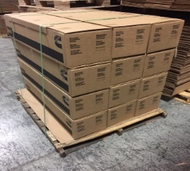
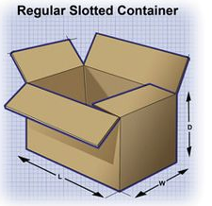
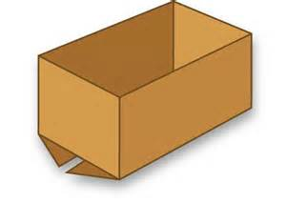
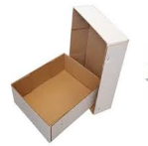
PDS Form Cost Data - Primary Container Section 包装信息表成本信息 - 一级包装部分
每独立纸箱为一级包装
Bulk Pack大包装箱此种包装类型请不用填写此部分信息
Regular Slotted Container(RSC)
Half Slotted Carton with Cover (HSC with Cover)
Half Slotted Carton without Cover (HSC without Cover)
Full Telescope Design
Style Carton (FTD)
Full Over Lap Carton (FOL)

Slide 17
PCDS Internal Dunnage Section 包装成本信息表内衬部分
Use the drop down menu to select the specific internal dunnage type items.使用下拉菜单选择具体的内衬类型 .
Manually enter the description of each type of internal dunnage here 手工输入每种类型的内衬的类型 .
Enter the quantity of each dunnage type used per container here 输入每个一级包装箱里内衬类型的数数量 .
NOTE: Internal dunnage items will be repeated for the number of containers in the unit load. Therefore, any corrugate liners or plastic film liner bags used for the entire unit load must be entered into the ‘Closure Section’ of the PCDS.
注意：内衬物应该是在单元运输包装内/上的多个包装箱里反复出现的。所以，用于整体单元运输包装的任何瓦楞衬里或者塑料膜材质的内衬袋，请把此部分材料输入到这张表的“Closure Material Information Section”部分
Enter the weight in kg for each type of internal dunnage used per container here对于每个箱子里使用的不同类型的内衬的重量（公斤） .
此图的封箱盖板和底部的衬板信息需要填写到“Closure Material Information”
Use the drop down menu to select the internal dunnage material composition NOTE: any foam materials needs special consideration and should be entered as OTHER-NOT-LISTED 使用下拉菜单选择内衬材料构成 注意：任何泡沫材料需要特殊考虑，并且应该选择“其他非列明” ，即 “OTHER-NOT-LISTED: .
The weight in kg for the amount of internal dunnage type will auto-calculate here based on your inputs in this section每种内衬类型的重量（公斤）信息将基于你之前的输入自动的计算到此表格里
NOTE: If there is no Primary container used enter the Bulk container information in the Internal Dunnage Section.
注意：如果没有一级包装，请输入大包装箱内包装信息在“Internal Dunnage Section”部分
The cost per container for each internal dunnage type will auto-calculate dunnage cost per container based on your inputs in the yellow cells on the left.每种内衬类型的成本将基于你黄色部分的手工输入将结果自动呈现到绿色份框里
Manually enter the piece price cost of each type of internal dunnage material used here 手工输入每种内衬类型 的每单位的成本信息 .

Slide 18
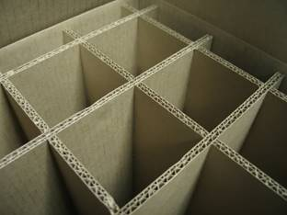
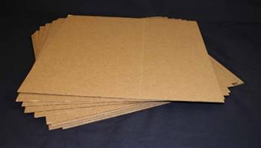
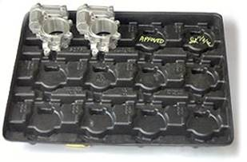
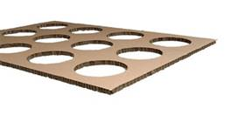
PCDS Internal Dunnage Section 包装成本信息表内衬部分
Partition 分割内衬
Layer Pad 分割内衬板
Tray 托盘
Die Cut内切式内衬

Slide 19
PCDS Secondary Container Section 包装成本信息表 二级包装部分
Use the drop down menu to select the specific container type item here. 使用下拉菜单选择具体的包装箱类型 .
Manually enter the specific container description 手工输入具体的包装箱类型描述 .
Manually enter the item cost for each secondary container type手工输入每种二级包装箱类型的价格
NOTE: It is critical if solid wood packaging materials are used for export that you select the ‘Wood ISPM15 compliant’ attribute here. .
Use the drop down menu to select the specific materials used here.使用下拉菜单选择具体的使用材料 .
Enter the weight of each container item here.在此数据每种包装箱类型的重量

Slide 20
PCDS Closure Material Info Section 包装成本信息表附件包装信息部分
Use the drop down menu to select the specific closure item here 使用下拉菜单选择具体的包装封箱材料 .
Manually enter the description of the specific closure materials here 手工输入具体的封箱材料描述 .
. Manually enter the specific closure material quantity for the entire unit load here
Manually enter the specific closure material weight per each closure item in kg NOTE: label should have ‘0’ kg entered as it is negligible. 手工输入每种封箱材料具体的重量
注意：对于“标签”，请将重量输入为0以忽略此信息。 .
The total closure material weights will be auto-calculated per each closure item in kg here 总的封箱材料重量将会自动计算并呈现在蓝色区域部分
Enter the closure material cost per item here 输入封箱材料的单位成本信息 .
The closure material costs will be auto-calculated for the entire unit load for each closure item used here 整体的运输单元的每种封箱材料的成本信息将自动计算并呈现在绿色区域部分
Use the drop down menu to select the specific closure materials used here. 使用下拉菜单选择具体的封箱材料类型

Slide 21
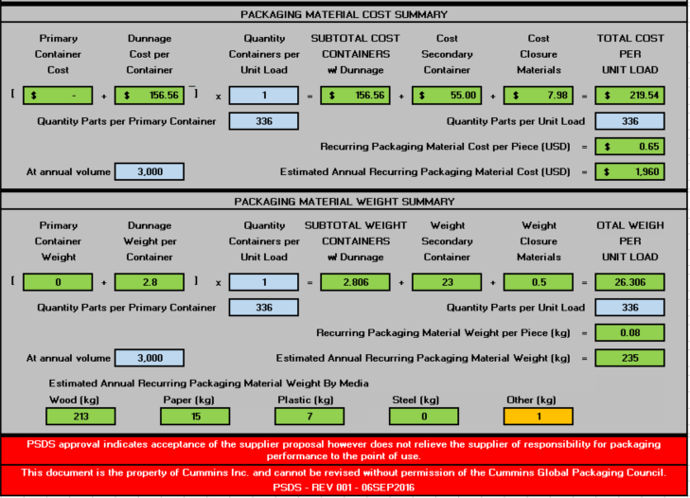
PCDS Cost and Packaging Material Weight Summary Section 包装成本信息表成本和包装材料重量总结部分
The summary section will all auto-calculate from the inputs previously entered in the PSDS and PCDS
此总结部分将从你之前输入的包装方案信息表和包装成本信息表里的信息自动生成

