Slide 1
Packaging Data Sheet Overview & Instructions
Cummins Global Packaging Council
August 13th, 2020
Internal Use Only

Slide 2
PDS Introduction

Slide 3
Introduction
In September 2016, Cummins published a new and improved version of the Cummins Packaging Specification template.
This form is to be completed by suppliers for Cummins to review and approve packaging. This is a proactive tool used with PPAP to avoid safety, quality, cost, and environmental issues related to improper packaging.
Please download the latest version of the PDS template from the Cummins supplier portal where you can also access Cummins Global and Site-Specific Packaging Standards.
Go to www.supplier.cummins.com
Click directly on the “Standards and Processes” link on the left menu bar,
➔ The packaging tools will populate within the main pane of the webpage
Download Packaging Data Sheet Template - Rev 2
Macros must be enabled to complete and save the template
Suppliers are to only send macro-enabled excel files

Slide 4
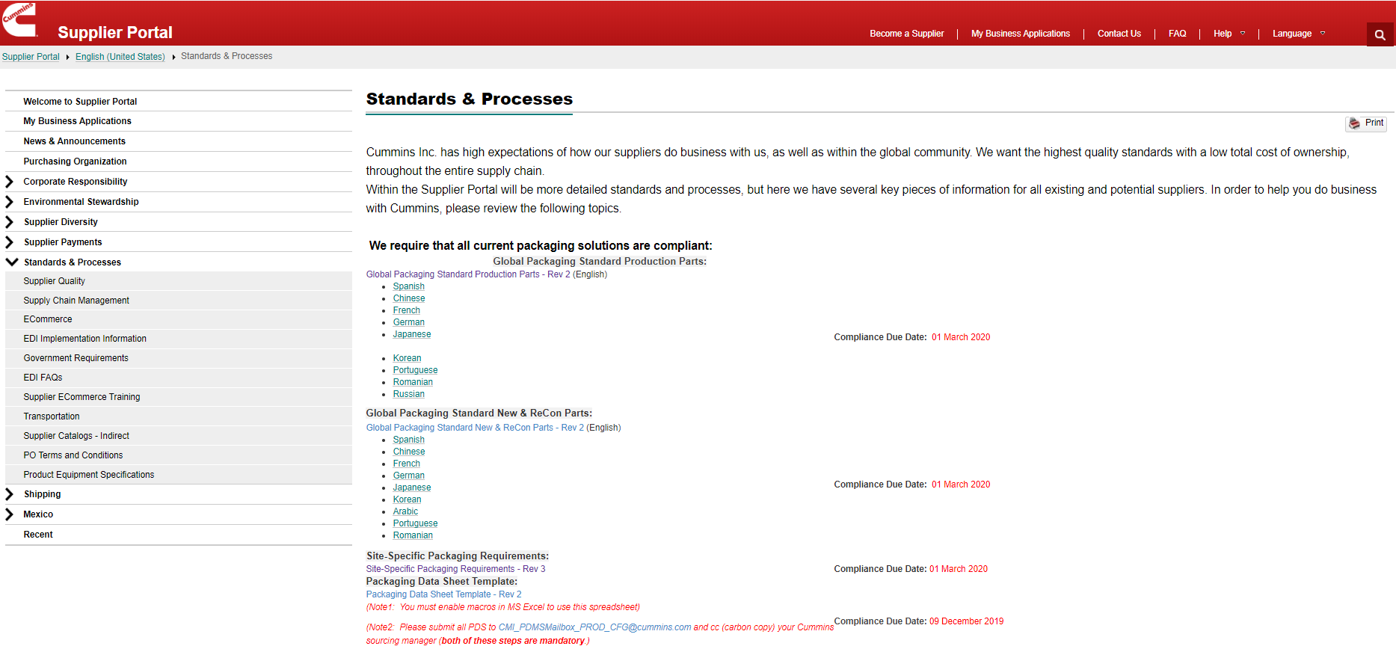
Supplier Portal (supplier.cummins.com)

Slide 5
Purpose for Packaging Review
Confirm part packaging proposals meet Global and Site-Specific packaging requirements
Confirm the packaging piece-price costs for production part deliveries to Cummins facilities
Prevent issues through a structured approval process at time of sourcing of the parts
Promote lean principles, optimize material flows

Slide 6
Packaging Approval Requirement
Required by Cummins Global Packaging Standards (Production, New & Recon)
Standards have been in-place since 2016
Approval is given by the cross-functional team at each Cummins receiving location
Applicable to all purchased parts sourced after February 2014
Approval means that the Cummins receiving location(s) agrees that the Global Packaging Standards and any site-specific requirements are met
Approval does not mean that Cummins accepts any damages when this packaging is used
Supplier still owns the responsibility for their packaging performance and part quality

Slide 7
Why do we need a PDS review & approval process?
Open and maintain dialogue about part packaging earlier within the sourcing process
Guide our suppliers towards a right-first-time proposal
Give the facility opportunity to review and comment on the proposed packaging system before it causes issues
Mitigating any quality concerns, safety risks, production interruptions
Determine opportunities for improvements by using packaging material cost ($) and material weight (kg)
Ex: Justification in returnable packaging assets

Slide 8
PDS T-Chart
Pre-PDS Process | With PDS Process
Supplier did not quote packaging costs separately from piece price | Supplier quotes packaging as a separate line item – Cummins and supplier align to get the correct packaging for lowest total cost
Little to no guidance from Cummins to Supplier about what packaging will work best for the plant | Cummins receiving location provides specific packaging requirements and will provide constructive feedback to all proposals
First observation of packaging for many plant stakeholders is when it is used (potentially disruptive) or a photo ahead of time with incomplete information to make a judgement | Quick, electronic, cross-functional review of a detailed proposal, pre-production, by critical facility stakeholders
Large resource expenditure to “clean up” issues at Cummins and supplier after-the-fact | Proactive review avoids many costly issues related to Safety, Quality, Pack quantity etc.

Slide 9
Process Overview

Slide 10
Top Issues to Prevent
Non-stackable packaging in transport or warehouse
Package unsafe to move/store/use/dispose – ergonomic, safety, and/or environmental concerns
Packaging does not meet minimum part preservation (corrosion prevention) requirements
Package insufficient for export
Packaging weight estimations are incorrect – OSHA concerns
Part damage in transportation, package insufficient to support product during transportation
Wrong label format – receiving interruptions
Wood packaging not ISPM-15 compliant – violation of international shipping regulation
Wrong packaging materials used, wrong closure method
Ex: Metal strapping/banding is banned across all Cummins facilities, unless written exception provided by a facility
Wrong pallet type or construction – does not meet minimum Global or Site-Specific requirements

Slide 11
Stakeholder Reviewers
Packaging: General and site-specific packaging requirements
HSE: Ergonomics, safety, environment/materials
Logistics: Transportation, warehousing, internal logistics
Materials: Align minimum order quantities, fixed lot multipliers, and standard pack quantities (unit loads)
Operations: Part orientation, package use, labels/barcodes
Supplier Quality: Part protection and preservation

Slide 12
PDS Approval Flow & Timeline
Request or business award
Reply to supplier within 10 days
5 Days
1 Day
1 Day
1. Supplier
RESPONSIBLE
2. Sourcing Manager
ACCOUNTABLE
3. Plant Packaging Representative
Complete Proposal PDS Form
Confirm PDS Form Complete
Packaging piece price costs match quote
Identify stakeholders
Check compliance to requirements
Route for approval
Upload into PDS
2 Days
5 Days
1 Day
4. General Packaging Requirements Review
5. Plant Cross-functional Review
6. Plant Packaging Representative
Review comments received from stakeholders
Review PDS Form
64-point general packaging requirements review
Part/line/plant specific requirements review if known
Exceptions highlighted
Provide Comments of acceptance, additional requirements or recommendations
Communicate approval or issues to Supplier and Sourcing Manager

Slide 13
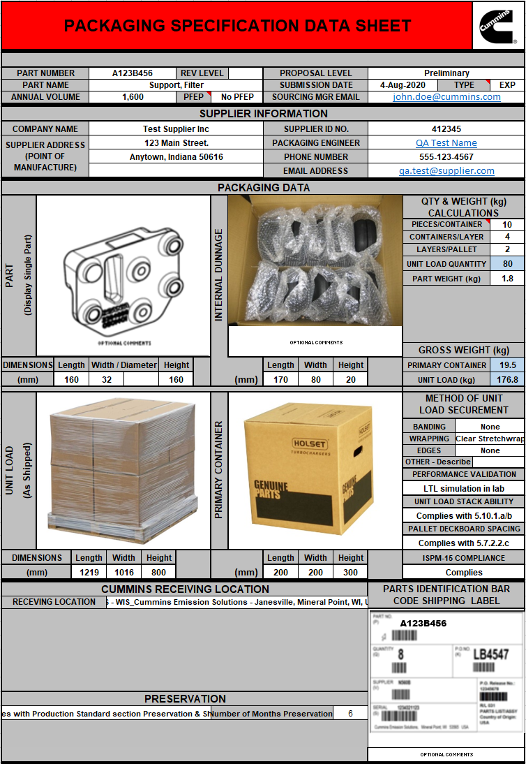
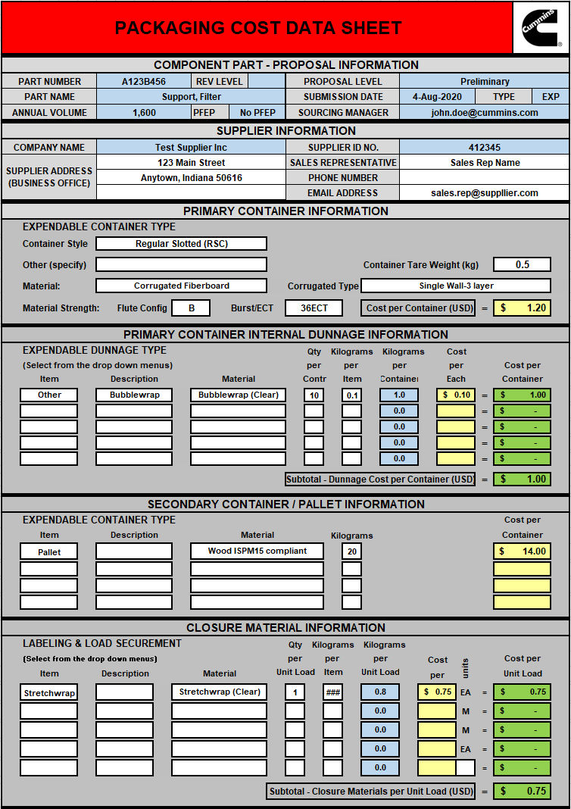
PDS Structure
The Packaging Data Sheet (PDS) is composed of two worksheets within the document:
Packaging Specification Data Sheet (PSDS)
Packaging Cost Data Sheet (PCDS)
Suppliers are required to complete both the PSDS and PCDS worksheets before they submit their PDS file
Please read both PSDS and PCDS instructions, and use the provided Checklist, to ensure completion before submission.

Slide 14
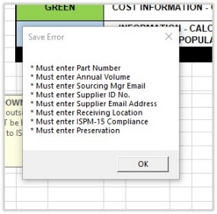
PDS Minimum Requirements
Requirement zones
Minimum PDS submission requirements:
Cummins Part Number, Part Annual Volume
Cummins Sourcing Manager Email Address
Supplier Email Address, Supplier SIM ID Number
SIM number is six digits, begins with a 4, ask sourcing manager if unknown
Cummins Receiving Location
Preservation – Standards reference, and months of preservation active packaging materials provide
Fulfilling the minimum submission requirements does not mean a PDS will automatically be approved
Save error due to not meeting minimum requirements

Slide 15
PDS Instructions

Slide 16
Packaging Specification Data Sheet
The Packaging Specification Data Sheet (PSDS) acts as the engineering specification for supplier packaging systems*
Measurements are to be given using the metric system
Packaging system: the primary, secondary, and tertiary level packaging designs, all assembled together
The QTY & WEIGHT (kg) CALCULATIONS section is used to determine unit load quantity and weight
Suppliers are to enter key pieces of information in the white cells of this section
PIECES/CONTAINER: Parts per primary packaging, often a box or carton. Confined to one layer on the packaging system
CONTAINERS/LAYER: Primary packaging per one layer on stack (if applicable)

Slide 17
PSDS Component & Supplier Information
Select from the TYPE drop down whether PDS is expendable (EXP) or returnable (RET) packaging
Enter
Cummins Part number here
Select from the drop down whether PDS is Preliminary or Change Proposal
Enter Cummins Sourcing Managers email address here (NOTE: Approval or Revisions Required Notifications will be automatically sent to the Sourcing Manager)
Enter Part noun name description here
Projected Annual Volume is entered here
Enter the 6-digit Supplier SIM# assigned by Cummins Sourcing Manager here for this Supplier
Enter the Supplier Packaging Contact phone number and email address here (NOTE: Approval or Revisions Required Notifications will be automatically sent to the Supplier)
Enter the Supplier name and address for the point of manufacturing here
Enter the Supplier Packaging Contact Person’s name here

Slide 18
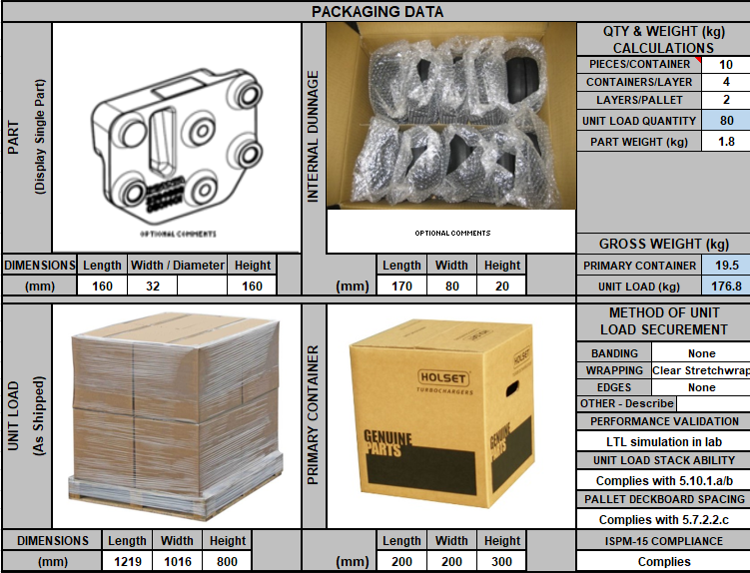
PSDS QTY & WEIGHT CALCULATIONS
PIECES/CONTAINER: Enter the total number of parts packed in the primary or bulk container (pallet-box, crate); only consider the parts that directly touch the base-level container
CONTAINER/LAYER: Enter the number of primary containers per a single layer of the unit load (pallet load) here. If a bulk container is used, enter “1”
LAYERS/PALLET: Enter the number of layers of primary containers per unit load (pallet load) here. If a bulk container is used, enter “1”
PART WEIGHT (kg): Enter tare weight of the part only here. Only enter measurements in metric, failure to do so may result in a PDS rejection

Slide 19
PSDS Packaging Data Section
Place jpeg photographs in the appropriate sections
Select from the appropriate drop downs based on the method of securement used
Enter dimensions in mm in all dimension sections
Indicate what packaging performance validation testing was done
Supplier is required to confirm if their packaging complies with the Cummins Global Packaging Standards Pallet Construction requirements and wood regulations. Check the appropriate boxes here

Slide 20
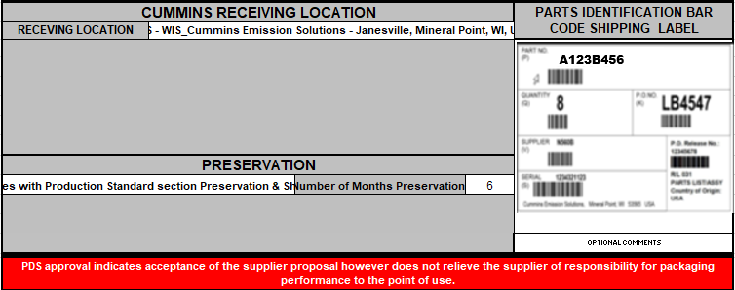
PSDS Cummins Receiving Location, Preservation, AIAG Shipping Label
Place a jpeg photo of the AIAG Bar Code Shipping Label here
Select the Cummins receiving plant location from the dropdown
Select the Cummins Packaging Standard and number of months preservation met by the PDS packaging system
NOTE: The approval of this PDS Form does not negate the responsibility of the Supplier for the performance of this packaging. Only that Cummins approves that you have met the applicable Packaging Standards and plant specific requirements

Slide 21
Packaging Cost Data Sheet
The PCDS acts as the packaging bill of material
Suppliers must list all materials they plan to use in their packaging systems within the PCDS tab.
Packaging component materials
Quantities used
Per piece weights and costs
If a supplier is claiming their part meets part preservation requirements, they must prove this by listing any active packaging components deployed (VCI, desiccant).
Only itemized packaging material costs for expendable packaging material should be entered into the PCDS

Slide 22
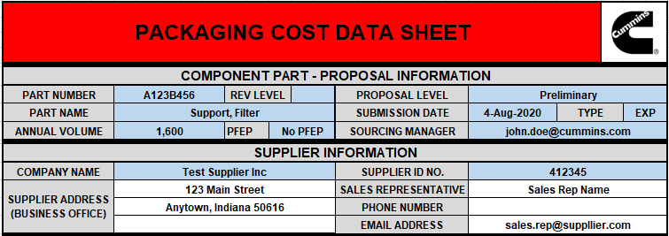
PCDS Component & Supplier Information
All the blue fields will autofill from the input of the PDS form. No need to enter redundant data points

Slide 23
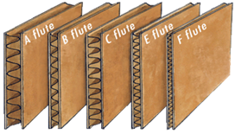
PCDS Primary Container Information
Use the drop down menu in this cell to select the specific container style
Manually enter the cost per primary container here
Use these drop down menus in this cell to select the specific corrugated material type .
Manually enter the empty container weight here .
Manually enter OTHER container style not listed in the drop down menu for container style .
Use these drop down menus in this cell to select the specific container material .
Burst/ECT: Enter the performance specification for any corrugated fiberboard container. This specification is always listed on the box certificate.
Flute config: Enter the flute configuration for any corrugated fiberboard container.
Example: “BC” could be listed for a double wall-5 layer container type.

Slide 24
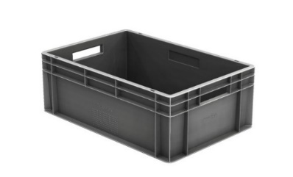
Primary Container Examples
Regular slotted carton (RSC) style
PRIMARY CONTAINER: The smallest unit of containerization of the packaged part.
Half slotted carton (HSC) style
Full overlap carton (FOL) style

Slide 25
PCDS Internal Dunnage Information
Manually enter the description of each type of internal dunnage here
Enter the quantity of each dunnage type used per container here
Enter the weight in kilograms for each type of internal dunnage used per container here
Use the drop down menu to select the specific internal dunnage type items
Kilograms per Container auto-calculates the total dunnage weight per line item in the packaging system
Cost per Container auto-calculates the total dunnage cost per line item in the packaging system
Internal dunnage items will be repeated for the number of containers in the unit load.
Therefore, any corrugated liners or plastic film liner bags used for the entire unit load (such as overpack packaging) must be entered into the Closure Material Information section of the PCDS.
Use the drop down menu to select the internal dunnage material composition (NOTE: any foam materials needs special consideration and should be entered as OTHER-NOT-LISTED)
Manually enter the piece price cost of each type of internal dunnage material used here

Slide 26
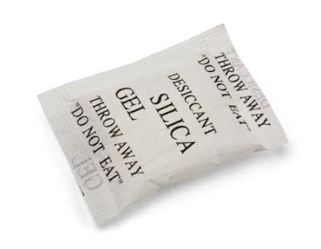
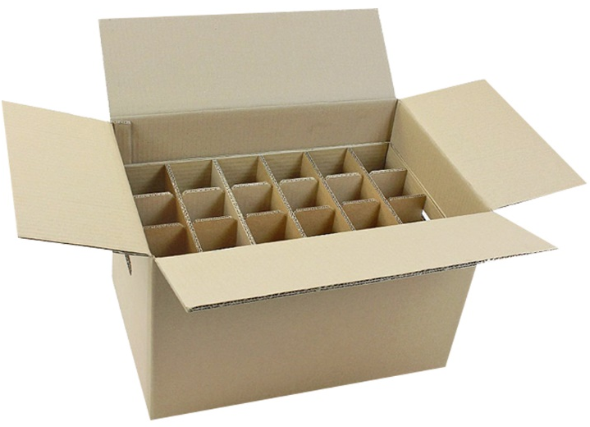
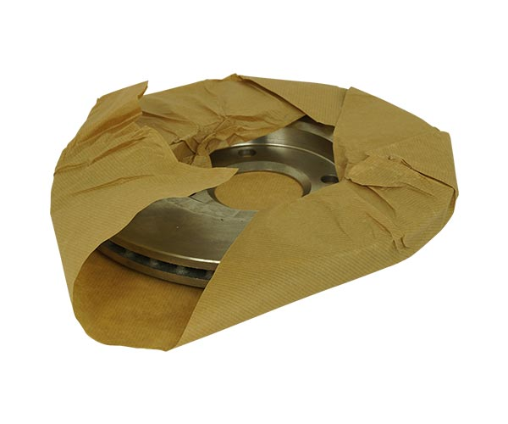
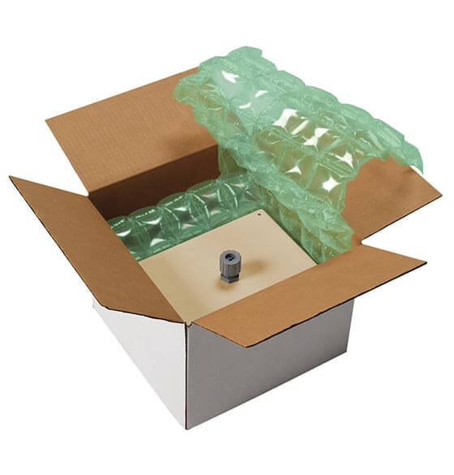
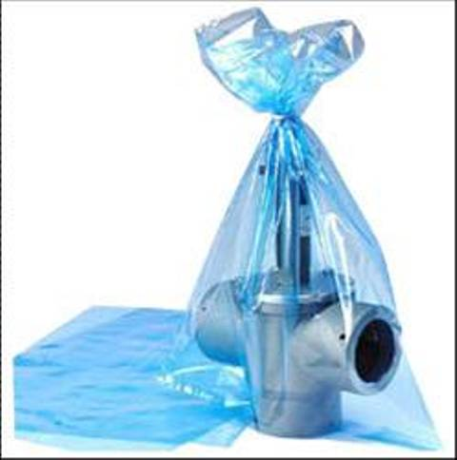
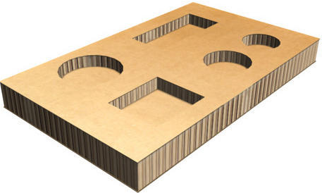
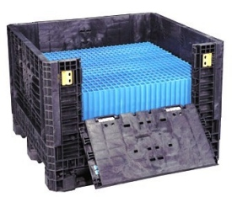
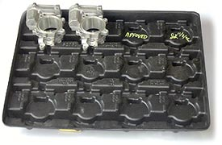
Internal Dunnage Examples

Slide 27
PCDS Secondary Container / Pallet Information
Use the drop down menu to select the specific container type item here
Manually enter the specific container description .
Enter the weight of each container item here
It is critical if solid wood packaging materials are used for export that the materials are specified as “Wood ISPM15 Compliant.”
Failure to do so will result in an automatic rejection of the PDS by the Cummins packaging representative.
Use the drop down menu to select the specific materials used here
Manually enter the item cost for each secondary container type
Ex: ISPM15 certification stamp

Slide 28
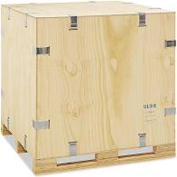
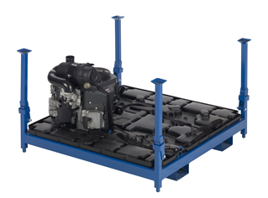
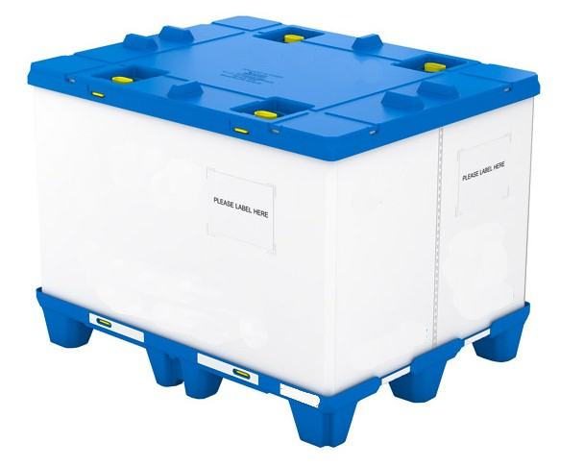
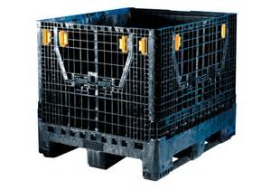
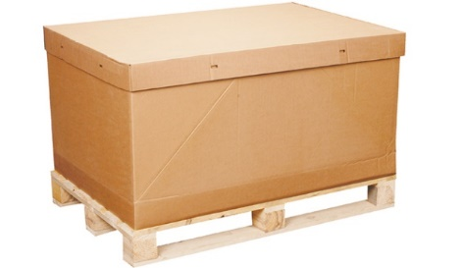
Secondary Container / Pallet Examples

Slide 29
PCDS Closure Material Information
Manually enter the specific closure material quantity for the entire unit load here
Manually enter the specific closure material weight per each closure item in kg (NOTE: label should have “0” kg entered as it is negligible) .
Use the drop down menu to select the specific container type item here
Manually enter the specific container description
Kilograms per Unit Load auto-calculates the total closure material weight per line item in the packaging system
Cost per Unit Load auto-calculates the total closure material cost per line item in the packaging system
Use the drop down menu to select the specific closure materials used here.
Enter the closure material cost per item here

Slide 30
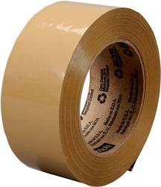
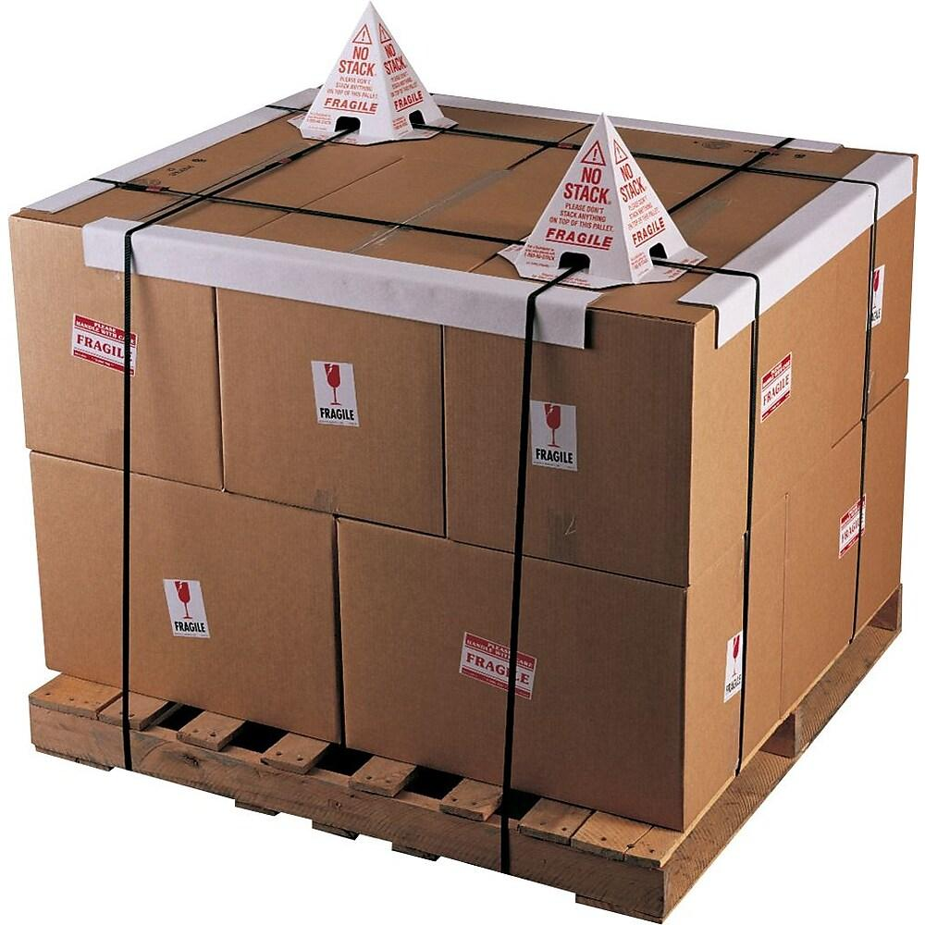
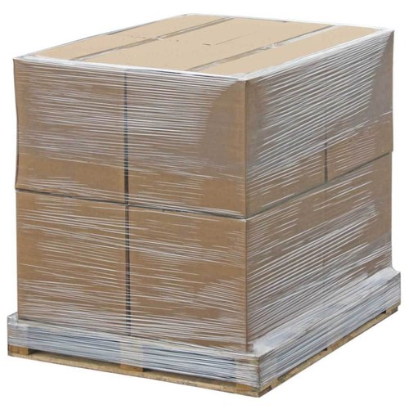
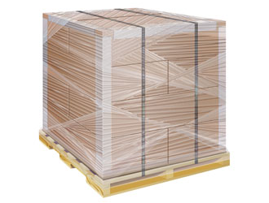
Closure Material Examples
DO NOT STACK (“Other”) cones should be listed as closure material
Corner-boards (“Corner/Angle”) should be listed as closure material

Slide 31
Completed PDS Calculations
The summary sections will all auto-calculate from the inputs previously entered in the PSDS and PCDS
Calculations for both packaging material costs and weights
As well as estimated annual recurring material costs and weights

Slide 32
PDS Submission

Slide 33
Where to submit a PDS?
Once a PDS is completed, suppliers are to submit their file(s) using one of two methods:
Suppliers may submit their PDS file(s) using the traditional process method, by emailing the file directly to their Cummins sourcing manager
For first-time submissions, suppliers may want to use this method to ensure they are completing the template correctly
Suppliers can submit their PDS file(s) directly into Cummins Packaging Data Management System by emailing CMI_PDMSMailbox_PROD_CFG@cummins.com

Slide 34
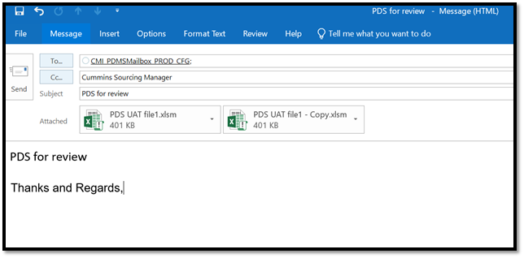
Common Email Address Submission
Suppliers must meet the minimum PDS requirements and follow the process steps below to successfully submit their PDS file(s) through the common email:
Email CMI_PDMSMailbox_PROD_CFG@cummins.com
CC the Cummins Sourcing Manager
Type a subject in the subject line
Example: “PDS for Review”
Attach 1 – 10 PDS files to the email
Type text in the body of the email
Example: “Please review these submissions”

Slide 35
Suppliers With Any Questions…
CONTACT your Cummins Sourcing Manager directly
The sourcing manager will either…
Answer your questions
Locate the site packaging engineer that can best answer your questions
?

